Slide 1
College Admission Suggestion System
Abstract Presentation

Slide 2
Introduction
People often find it difficult to choose the right college and the right course for higher education.
Difficulties:-
Analysing scores
Analysing locations
Analysing ranks
Analysing possibilities for admission
Analysing colleges
Analysing locations of colleges
Availability of accommodations
Modes of transport

Slide 3
Objective
Collects user details(marks,extra curricular activities)
Evaluates eligibility
Suggest best colleges
College reviews
Admission details

Slide 4
Software Requirement
Python
Flask
SQLite3
Jinja
HTML
CSS
Java Script

Slide 5
Process
Student Details
Marks,preferred location,quota,course
List of Colleges in given location
Machine Learning Algorithm
College information
Name,Location,no of seats,branch details
Cut-Off of courses of last five years
Modes of transport

Slide 6
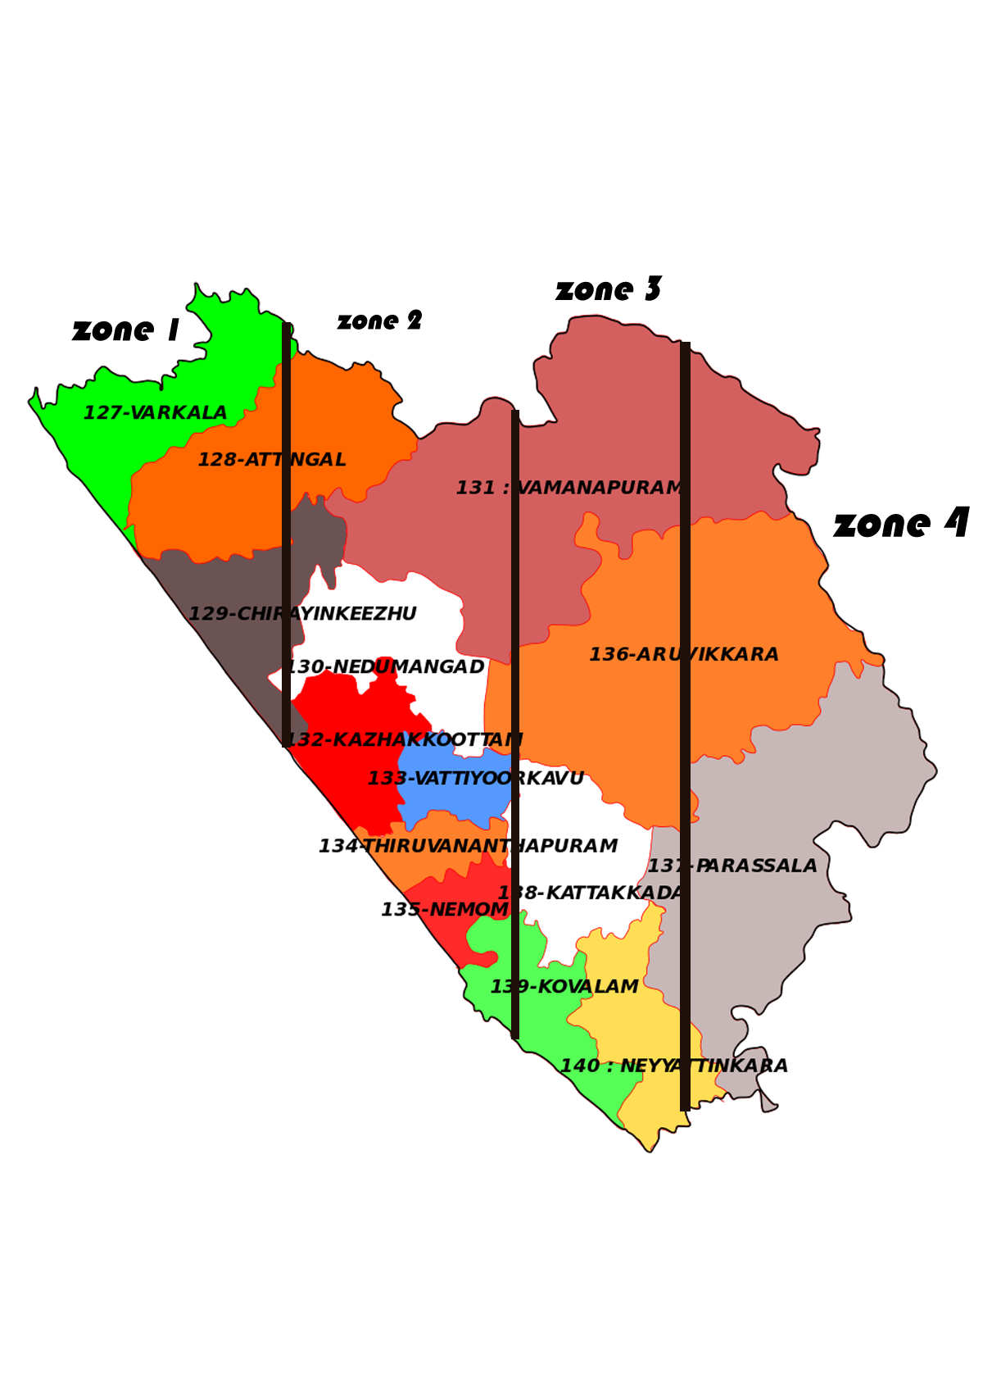
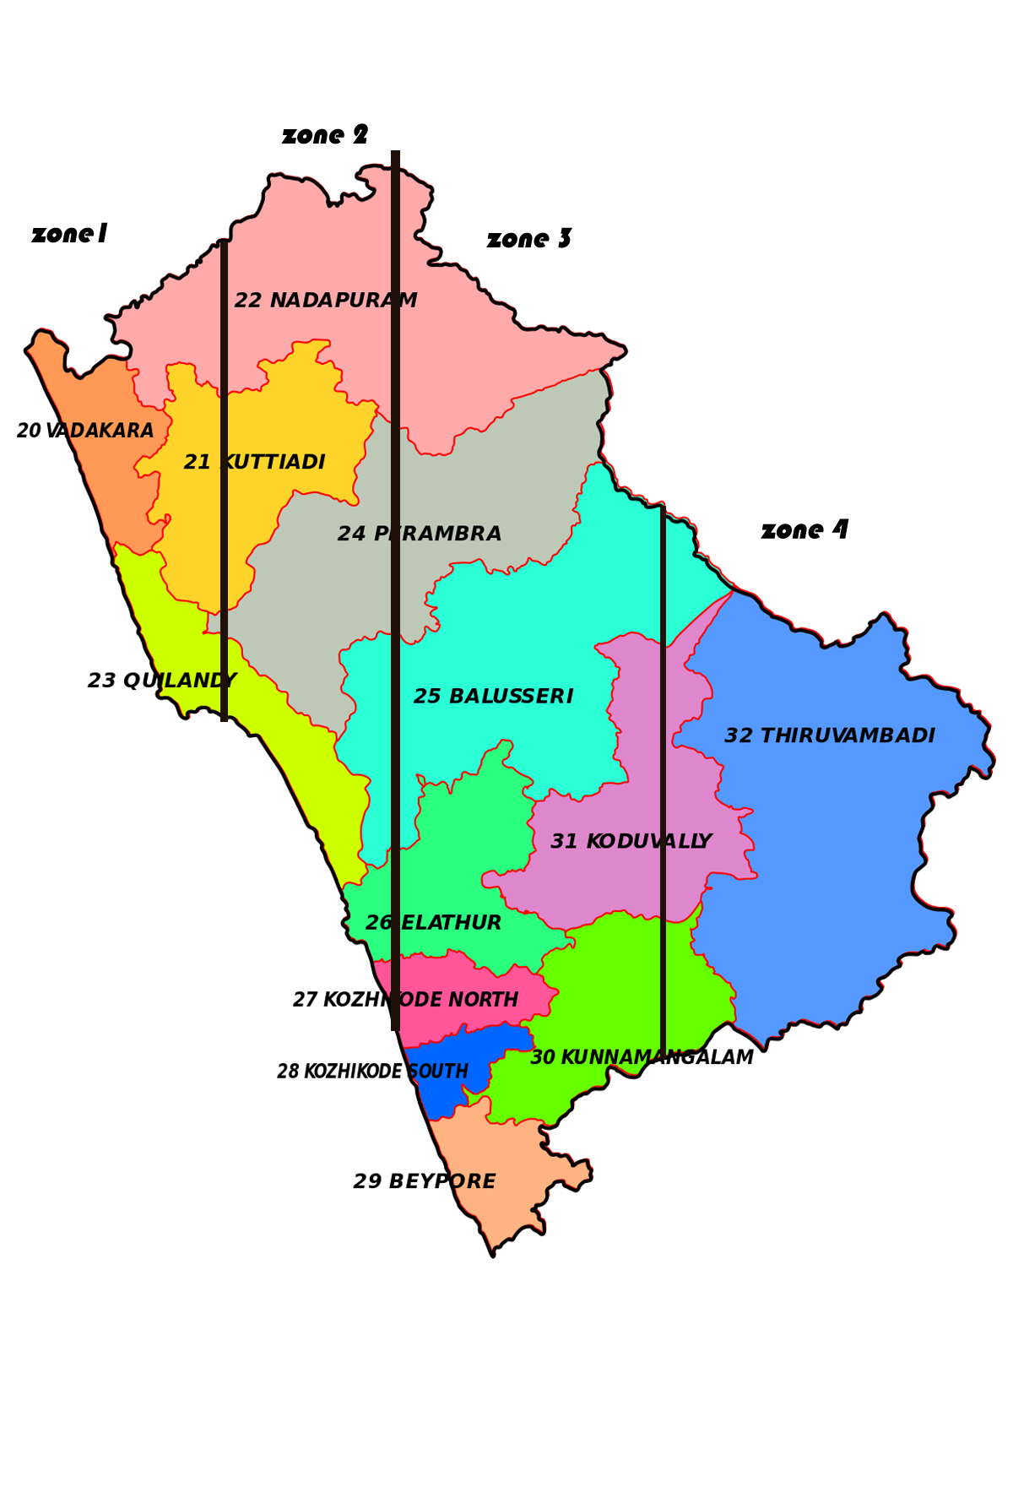

Slide 7
Thank You

